Slide 1
Digital Strategy

Slide 2
Objectives
Aligning user experience strategy with integration decisions
Supporting role
Define data strategy to support user experience needs (CRM)
Align on a single account security solution
Determine the best technology solution to ensure efficient experience management and platform performance
Collaborate on require short and longer term resource model
Leading role
Determine short term (2022) and longer term (2023+) user experience priorities
Short term: address largest user experience gaps while we converge to a single platform
Longer term: create user experience differentiation through a single white label platform
Ensure a solid foundation for all audiences while building a user design center of excellence
Addressing the biggest experience gaps while leveraging partner resources to expand current capabilities

Slide 3
Roadmap

Slide 4

American Trust: Building Our Brand
TPA
Melissa Geertz
Theresa Ayers

Slide 5
Longer term: creating experience differentiation
American Trust
Institutional
Advisor/TPA
TPA Specific
Advisor Specific
Shared Content
Book of business information
Notifications
Plan and book level reporting
Data exports
User access management
Online administration tasks
Data submission
Managing delegated services
TPA education/content
Read access to advisor content
Investment management
Employee education/advice
Plan oversight/vendor selection
Advisor education/content
Read access to TPA content
SSO
Employer experience using Relius APIs and custom UX
Pass Through
Employee experience using Relius APIs and custom UX

Slide 6
Short term proposal (2022): intermediary foundation
MVP 1: Setting the foundation
Create data structures in Salesforce to support book of business reporting for intermediary audiences (TPA, advisor, partner)
Define user profile needs and required data for integration with account security process
Create initial dashboard with key book of business data
Create SSO to Relius sponsor site from intermediary site
MVP 2: Expanding intermediary site features
Expand book of business and plan level information
Create a resource center (educational content, forms, etc.) that can be leveraged by all intermediaries (TPA, advisor and partner)
Create aggregated plan notifications view (centralize all tasks for book of business)

Slide 7
Longer term proposal (2023+): differentiation
Intermediary: Partner, Advisor, TPA
Move investment lineup and model management online
Rollout plan and book level reporting
Leverage PensionPro workflows where we have common needs
Enable users to download client data
Allow updates to recordkeeping data
Expand resource center capabilities (e.g., proposals)
Integrate content from strategic partners (e.g., iJoin, Fiduciary Decisions)
Plan sponsor and participant
Partner with Relius to influence core UX and long term data and micro service strategy
Evaluate value added opportunities vs. core functionality to create user experience differentiation

Slide 8
Intermediary experience: partners, advisors, TPAS
Current
Post Integration
2022-23
Advisor
Custom website
Relius Sponsor Web
Relius Advisor Web
American Trust Intermediary Site
TPA Features
Administrative tasks
Data submission
Managed services
TPA
Relius Sponsor Web
MATC
Pension Pro
Partner
None
SSO and integration
Advisor Features
Investment management
Employee education
Plan performance
Benchmarking
Fiduciary Decisions
iJoin
Advisor
PartnerLens + Relius Advisor Web
Shared Dashboard
Book of business info
Notifications
Plan/book level reporting
Data exports
User access management
Resource center
TPA
Relius Sponsor Web
Onboarding Portal
Partner
None
2023+
Note: “Dashed” items represent longer term items post integration

Slide 9
iJoin Advisor Roadmap
2022 Priorities
Managed account marketplace
Phase 2 Leafhouse: add sidecar investments
Allows outside advisors to act as 3(38) (DFE model)
Other managers
ProNvest (in QA)
Franklin Templeton (Q2)
PIMCO (based on their TD funds)
Stadion (driven by Omni partner Ameritas)
BlackRock (similar to FT arrangement)
Advisor alert if participant adds outside assets
May tie to campaign manager for automation
Data integrity checks in ACT (salaries, emails, etc.)
More ACT analytics (participant usage, outside data collected, etc.)
2023+ Priorities
ACT enhancements to analytics portal
Investment focus (trend reporting, target date usage, default fund usage, etc.)

Slide 10
Plan sponsor experience
Current
Post Integration
AT Onboarding Portal
American Trust
Plan Sponsor Experience
2022-3
Relius Sponsor Web
AT Onboarding Portal
Integration
Relius Sponsor Web
SponsorLens
PensionPro
Relius Sponsor Web
FIS/iJoin Roadmap
2023+
Note: “Dashed” items represent longer term items post integration

Slide 11
FIS Relius Sponsor Web Roadmap
2022 Priorities
None
2023+ Priorities
Self service compliance (TPA experience light)
In Omni beta
Not the focus for Relius near term
Data as a service
Client onboarding visibility for TPAs
New plan health/analytical dashboards
Beta testing within Omni

Slide 12
iJoin Plan Sponsor Roadmap
2022 Priorities
Annuity/Allianz option
Rollover options
Penchecks
MATC
Millenium Trust
Will be part of ACT for automated force outs
Fee reporting and transactions
Includes setting fee by advice provider
Can be plan level by setting up multiple advisor level fee schedules
Looking at fee breakout by advisor, RK, etc.
2023+ Priorities
Additional annuity integrations

Slide 13
Participant experience
Current
Post Integration
iJoin Enrollment and Managed Accounts
American Trust
Participant Experience
2022-3
Relius Participant Web
iJoin Enrollment and Managed Accounts
Relius Mobile App
Integration
Relius Participant Web
Relius Participant Web
Relius Mobile App
Salesforce Participant Web/Mobile
FIS/iJoin Roadmap
2023+
Note: “Dashed” items represent longer term items post integration

Slide 14
FIS Relius Participant Web Roadmap
2022 Priorities
iJoin annuity product (June 2022)
In-plan solution (Allianz)
Targeted messaging
SSO to iJoin
iJoin e-notifications (launched DEC 2021)
Dashboard widget
SSO to iJoin
Manage e-notification elections
Online distributions denials (June 2022)
Messaging back to participant
Mobile app
Add investment elections (Q4-2022)
Add investment transfers (Q4-2022)
Support for multiple mobile apps (Q1-2022)
2023+ Priorities
Response web capabilities
Expand SSO integration with app where it is responsive
First focus is for access to e-reports (statements)
iJoin site performance
Change web service calls (consolidated vs. individual)
Batch file processing
Mobile app
Add iJoin retirement income projection
Add iJoin enrollment integration

Slide 15
iJoin Participant Roadmap
2022 Priorities
Explore
Currently 10 modules
Healthcare
Budget
Distribution analysis
Savings sequence
Auto acceleration integration
Considered in projection
Allow PPT to see/modify in experience
Use profit sharing formula in income projection
Electronic delivery elections and notice delivery (Dec 2021)
Document upload facility (plan by plan)
Looking to add batch capability
2023+ Priorities
Participant statements
Add HSA bucket (5th source) to improve income projection calculation

Slide 16
iJoin Foundational Roadmap
2022 Priorities
Tech debt upgrades
Better performance
Not related to FIS upgrades for improvement
Security related items to improve login
Reduce iJoin branding/visibility (1H-2022)
Ability to add advisor or partner logo in place of
Improves SSO integration with Relius and help for failures
2023+ Priorities
FIS next generation impacts

Slide 17

Retirement Experience Roadmap
04
Milestones
03
Milestones
02
Milestones
Intermediary MVP 3 complete
Intermediary MVP 4 in development
Sponsor or PPT MVP 1 in development
Long term plan sponsor roadmap
Long term participant roadmap
Promote FIS/iJoin releases
Resource model for 2024
01
Milestones
Intermediary MVP 2 complete
Intermediary MVP 3 in development
Begin plan sponsor roadmap
Begin participant roadmap
Promote FIS/iJoin releases
AT.com updated for login
Long term intermediary roadmap
Intermediary MVP 1 complete
Intermediary MVP 2 in development
Promote FIS/iJoin releases
Resource model for 2023
Security strategy
Data and technology strategy
Design consulting partner selected
AT.com updated with TPA
Intermediary site architecture
Intermediary MVP 1 in development
Q3
1H-2022
2H-2022
1H-2023
2H-2023
Items in red are overlapping needs and key decisions for LT Trust integration
Items in blue assume consulting or expanded user experience team

Slide 18
Design and Data

Slide 19
What is important to our clients
Understanding our clients needs
Financial Advisor
TPA
Partner
Distribution Channels
Packaging their skills and our solutions to position their expertise
Improving employer and employee outcomes
A strong partner to help them build their business
Client servicing through automation and online capabilities
Designing retirement plans that align with client financial and social goals
Reducing client effort and risk through administrative outsourced solutions
Online client management of delegated tasks and data integration
Reporting on product results (sales, asset and client growth, revenue, distribution analysis)
Product data Insights (feature utilization, win/loss analysis, client success measures, product benchmarking)
Management of product collateral and communications
Larger firms: will focus more on data integration with industry firms (Envestnet, RPAG) or require custom data feeds
Smaller firms: broader mix of data integration/requests and the desire to use our digital capabilities

Slide 20
What TPAs need
Theresa Ayers and Phil Maness notes from TPA interviews re: TPA Portal
Administration
Online distribution submission and approval
Online loan submission and approval-include loan activity with principal and interest for any specified range of time
Clean 5500 statement package
For 3(16), need authorized signer authority
Allow multiple distribution fees or pre-populated schedule
Downloads (system specific) and API opportunities
Easy vesting update capability
Corrective distributions online
Easy payroll upload
Ability to download participant notices or to upload TPA notices to recordkeeper for distribution
Secure data transmission
Ability to add and modify participant information
Dashboard
TPA controls security/ability to manage users and reallocate plans
Book of business dashboard with easy drill down plan access
Notification of approvals, reports, messages, to appropriate parties
Single sign on to employer website
Reporting
Robust, clean on-demand reporting at the participant level
Detailed distribution reporting: full liquidation amount, tax withholding, forfeitures, fees, net payment, etc.
Forfeiture reporting-separate from withdrawal report and where forfeitures came from/how they have been used
Book of business summary data with drill down to plan level insights
Missed loan report/default report
View 1099’s
Confirmation reports for distributions and contributions
Scheduled reporting capabilities

Slide 21
What advisors need
Product Platform
Available products
Product information
Product proposals
Industry and regulatory updates
Plan Health Measurement
Measuring plan performance against stated goals
Fee benchmarking
Employee readiness reporting
Employee Education
Enrollment presentations
Communication campaigns
Enrollment kits
Enrollment meeting support
Investment Management
Investment lineup management
Model portfolio management
Investment reporting
Employee advice services
Product Feature Integration (consolidated experience)
iJoin advisor portal (participant health reporting, email campaigns)
Fiduciary Decisions (fee benchmark reporting)
MATC (model portfolio management)
Relius sponsor website (plan support and insights)
Brand folder (product collateral)
Dashboard and Reporting
Book of business summary data with drill down to plan level insights
Messaging (to/from American Trust)
Ideally across all related parties to a plan
Block of business and single plan reporting
Less data downloading compared to TPAs
Heavier plan health and investment related focus

Slide 22
What partners need
Sales Pipeline
Proposal activity
Proposal close rates
Conversion activity and statuses
Product Performance
Win/loss insights
Termination activity and feedback
Product feature utilization
Client survey results
Product Positioning
Industry and competitive insights
Regulatory updates
AT Product roadmap
Product collateral
Dashboard and Reporting
Book of business summary data with drill down to plan level insights
Messaging (to/from American Trust)
Ideally across all related parties to a plan
Block of business and single plan reporting
Heavier product performance related focus
Product growth (plans/participants/assets)
Reporting against partner agreement SLAs
Distribution channel activity (total plans, sales, key advisors)

Slide 23
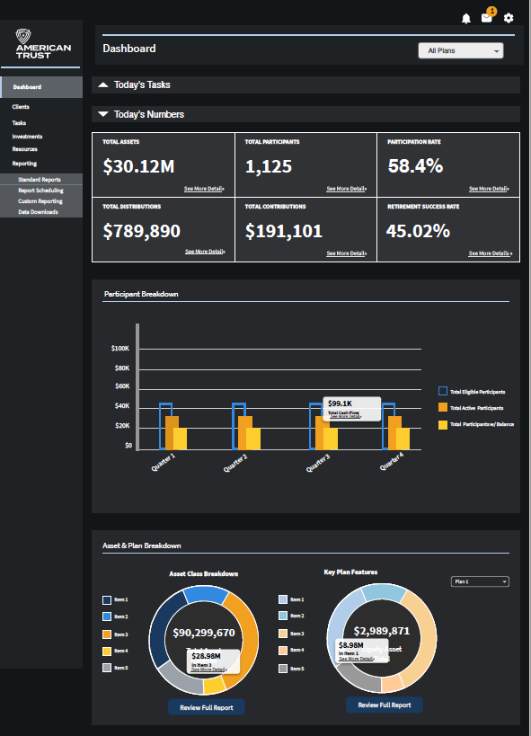
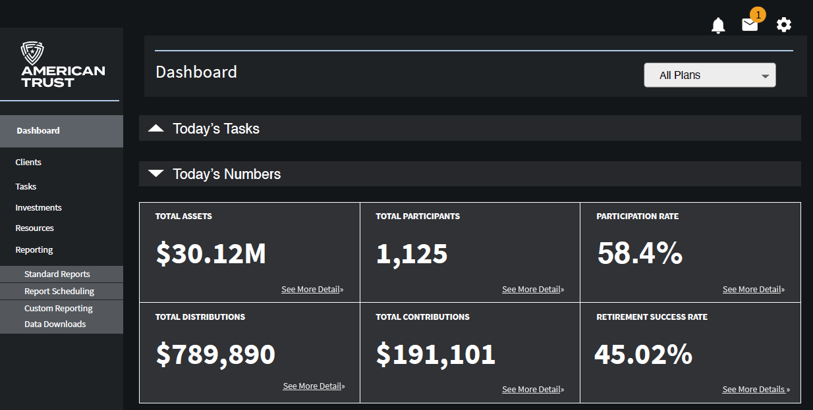

Slide 24
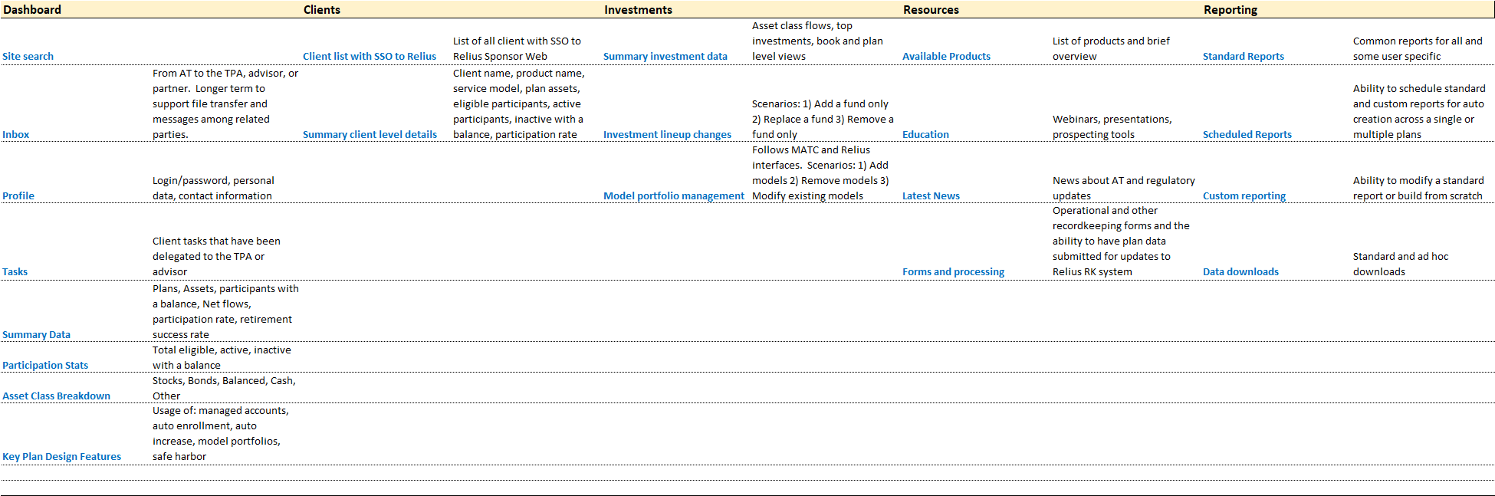
Top Layer

Slide 25
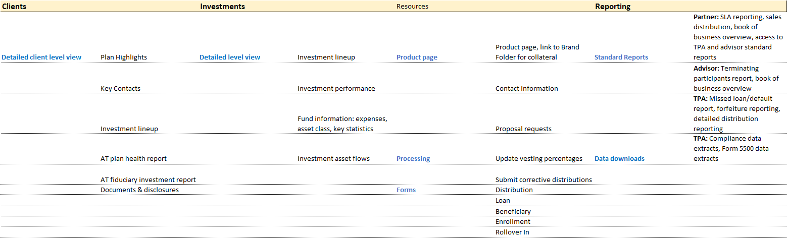
Drill down – second layer

Slide 26
Intermediary Site
Clients
Investments
Reporting
Resources
Dashboard

Slide 27


Dashboard Content
Tasks
Summary Data
Participation Stats
Asset Class Breakdown
Key Plan Design Feature Usage
MVP 1
MVP 2
Site Search
Inbox (from American Trust)
Profile
List of client tasks that have been delegated to the TPA or advisor
SSO to Relius web to complete
Total plans
Total assets
Participants with a balance
Net flows
Participation rate
Retirement success rate
Eligible participants
Active participants
Inactive participants with a balance
Stocks
Bonds
Balanced
Cash
Other
Managed accounts
Auto enrollment
Auto increase
Model portfolios
Safe harbor

Slide 28
Clients
Client List
Client Summary Data
MVP 1
MVP 2
List of all client with summary data
SSO to Relius Sponsor Web
Client name
Product name
Plan assets
Eligible participants
Active participants
Inactive participants with a balance
Participation rate
Plan Highlights
Key Contacts
Investment lineup
AT plan health report
AT fiduciary investment report
Documents & disclosures
Detailed plan information when selecting a specific client

Slide 29
Investments
Summary Data
Investment Lineup Management
Model Portfolio Management
MVP 1
MVP 2
Asset class flows
Top investments
Book and plan level views
Scenarios
Add an investment
Remove an investment
Replace an investment
Scenarios
Add a model portfolio
Remove a model portfolio
Change a model portfolio
SSO to Relius and MATC
Full investment lineup
Investment performance, asset class, expenses
Asset flows by investment
Participant elections by investment
Detailed plan information when selecting a specific client

Slide 30
MVP 1
MVP 2
Reporting
Standard Reports
Scheduled Reports
Custom Reporting
Data Downloads
Common reports
User specific reports
Ability to schedule standard and custom reports
Ability to schedule across a single or multiple plans
News about AT
Regulatory updates
Operational and RK forms
Plan data submissions for updates to Relius RK system (e.g., vesting)

Slide 31
MVP 1
MVP 2
Resources
Available Products
Education
Latest News
Forms and Processing
Overview of products available on the AT platform
Link to Brand Folder
Webinar
Presentations
Prospecting tools
News about AT
Regulatory updates
Operational and RK forms
Plan data submissions for updates to Relius RK system (e.g., vesting)
Product page with details
Link to Brand Folder for collateral
Contact information
Proposal requests

Slide 32
Clients: Book Level View
Plan | Product | Service Model | Assets | Participation Rate | Eligible Participants | Active Participants | Inactive Participants
ABC Company | American Trust | Full Service | $1,234,931 | 66.2% | 77 | 51 | 7
XYZ Company | American Trust | Unbundled | $934,119 | 64.7% | 34 | 22 | 2
GHI Company | Mutual of Omaha | Unbundled | $2,394,851 | 80.5% | 133 | 107 | 0
LMN Company | Johnson Financial | Full Service | $5,834,105 | 77.0% | 244 | 188 | 21
< 1-25 of 87 >
SSO Link to Relius plan sponsor web
Link to product page

Slide 33
Clients: Plan Level View
Contacts
TPA: Don TPA
Advisor: Jane Advisor
Sponsor Services: 800-555-1212
Participant Services: 800-555-1313
Plan Highlights
Managed accounts (Y/N)
Auto enrollment (Y/N)
Auto increase (Y/N)
Model portfolios (Y/N)
Safe harbor (Y/N)
Admin assist (Y/N)
E-delivery (Y/N)
Payroll integration (N/Provider)
Plan Reporting
Plan health report (link to recent)
AT fiduciary investment report (link to recent)
Documents & Disclosures
On Relius website in dedicated tab
Link to Relius sponsor web, or
Replicate documents here
Investments | Asset Class | Expenses | Assets | Percent
Vanguard `ABC | Large Blend | 0.08% | $234,931 | 14.7%
Pioneer XYZ | Midcap Value | 0.87% | $134,119 | 8.4%
BlackRock GHI | International Value | 1.02% | $394,851 | 24.7%
PIMCO JKL | Intermediate Bond | 0.44% | $834,105 | 52.2%
Total |  |  | $1,598,006
Link to MATC factsheet

Slide 34
Investments: Book Level View
Activity
Asset class flows
Top investments used (and total assets)
Investment lineup changes
Show correct eligible fund list by product
Ability to
Add an investment only
Remove an investment only
Replace an investment
Create sample investment change form
Model Portfolio Management
Show correct eligible fund list by product
Ability to
Add models to a plan
Remove models form a plan
Modify existing models in the plan
Direct them to MATC or Relius depending on model type

Slide 35
Investments: Plan Level View
Activity (by investment)
Contributions
Distributions
Net Flow
Participants with a balance
Participants with an investment election
Investments | Asset Class | Expenses | Assets | Quarter | YTD | 1 Year | 3 Years | 5 Years | 10 Years | Inception
Vanguard ABC | Large Blend | 0.08% | $234,931 | 0.45% | (0.11%) | 2.34% | 6.87% | 6.23% | 7.14% | 9.01%
Pioneer XYZ | Midcap Value | 0.87% | $134,119 | 0.45% | (0.11%) | 2.34% | 6.87% | NA | NA | 9.01%
BlackRock GHI | International Value | 1.02% | $394,851 | 0.45% | (0.11%) | 2.34% | 6.87% | 6.23% | 7.14% | 9.01%
PIMCO JKL | Intermediate Bond | 0.44% | $834,105 | 0.45% | (0.11%) | 2.34% | 6.87% | 6.23% | NA | 9.01%
Total |  |  | $1,598,006
Link to MATC factsheet

Slide 36
Resourcing

Slide 37
 | 2022 | 2023+
User Experience
Center of excellence | Michelle: Leverage process used for Wealth Management Michelle: Formalize model for long term structure | Centralize process at corporate level Review hire vs. outsource model
UX/UI | Consultant and Michelle : Drive UX strategy Consultant: Drive UI
Retirement Strategy/Roadmap | Steve: Industry research and experience roadmap Consultant: Secondary research and roadmap support | Review outsource model Extend process to plan sponsor and participant
Marketing | Melissa: Integration with corporate brand strategy Melissa: Content management | Align with broader Retirement and Trust integration
Technology Architecture
Security strategy | Review current/new solutions for go forward approach | Evolve strategies as needed
Data strategy | Architecture to support user experience strategy
Technology strategy | Role of Salesforce and related solutions Required supporting technologies
Development
Intermediary experience | Development team 1: Work on MVP 1 & 2 | Continue work on prioritized MVPs
Plan sponsor experience | Work with FIS/iJoin to promote and influence roadmap | Continue evaluation of FIS Relius/Omni strategy Create customization to differentiate from competition and other FIS platforms Development team 2 (if needed)
Participant experience | Work with FIS/iJoin to promote and influence roadmap

Slide 38
 | 2022 Focus | Resources | Cost
User Experience
Center of excellence | Continue to build out center of excellence started in NewEdge Wealth | Michelle Creighton | In budget
UX/UI/Research | Develop the UX/UI strategy and conduct client and related research | Craft (consulting) | $X
Retirement Strategy/Roadmap | Industry landscape and experience roadmap | Steven Schweitzer | In budget
Marketing | Content management and integration with corporate brand strategy | Melissa Goertz | In budget
Technology Architecture
Security strategy | Create solution for go forward approach Will solve for long term user strategy and LT Trust integration | John DiFini Sanjoy Nath | In budget
Data strategy | Architecture to support user experience strategy Will solve for long term user strategy and LT Trust integration | John DiFini Sanjoy Nath | In budget
Technology strategy | Role of Salesforce and other required technologies Will support long term user strategy and LT Trust integration | John DiFini Sanjoy Nath | In budget
Development
Intermediary experience | Execute on MVP 1 & 2 | Development Team (team structure) | Budget TBD
Plan sponsor experience | Work with FIS/iJoin to promote and influence roadmap | NA – leverage partners | In budget
Participant experience | Work with FIS/iJoin to promote and influence roadmap | NA – leverage partners | In budget

Slide 39
Next steps
Resource model
Determine best use of internal vs. external resources
Solicit and review outsource proposals
Design approach
Validate proposed design can be supported in Salesforce
Determine required Salesforce components
Security recommendation
Finalize whether we will use Identity Server, Salesforce or a custom solution
Technology and data
Role of Salesforce vs. other data solutions
Determine Salesforce cost based on projected growth
Determine technology gaps and solutions

Slide 40
Appendix

Slide 41
User experience working team
Audience | Team members | Key resources | Team members
Partner | Justin Morgan Burke Johnson Stacy Hoskins | Product | Michael Samford
Distribution channels | Jay Palmer | Marketing | Melissa Geertz Heather Weeks
Advisor | Burke Johnson (CO) Jay Palmer (TX) | EIT/Data Security | Bob Drelick John DiFini Fred Sear Sanjoy Nath Dan Leman Michelle Creighton
TPA | Theresa Ayers Phil Maness Katie Boyer, Darren Conner | Legal/Compliance | Elizabeth Yanik Neomal Abeysekera
Employer | Burke Johnson Stacy Hoskins Michael Samford Derek Pleasants Shelley Pike
Employee | Burke Johnson Stacy Hoskins, Michael Samford Tina Crawford, Derek Pleasants
AT Associate | Derek Pleasants, Tina Crawford

Slide 42
LT Trust Integration: WS1 Digital Team
WS 1 Team Members | Team members
WS1 Lead | Steven Schweitzer
Project Manager | Greg Wunderley
SMEs | Burke Johnson Fred Sear Derek Pleasants Tina Crawford Theresa Ayers Jay Palmer Stacy Hoskins Shelley Pike Justin Morgan Michelle Creighton Sanjoy Nath
Key Meetings | Team members
WS1 Meeting (weekly) | Steven Schweitzer Greg Wunderley Hamed Rafiee
Gap Meetings (3-5/week) | Varies by topic
User experience meetings (daily stand-up) | Steven Schweitzer, Michelle Creighton
Working group for intermediary experience (Bi-weekly and as needed) | Theresa Ayers Phil Maness Jay Palmer Justin R. Morgan Michelle Creighton Burke Johnson Darren Conner Sanjoy Nath
Sales team strategy overview (one-time) | Sales, Operations

Slide 43
What is important to our clients
Understanding our clients needs
Financial Advisor
TPA
Employer
Employee
Packaging their skills and our solutions to position their expertise
Improving employer and employee outcomes
A strong partner to help them build their business
Client servicing through automation and online capabilities
Designing retirement plans that align with client financial and social goals
Reducing client effort and risk through administrative outsourced solutions
Online client management of delegated tasks and data integration
Attracting and maintaining top talent with competitive benefit offerings
Helping employees achieve financial success
Effective self-service and integrated solutions to reduce plan administration
Leveraging key provider relationships to manage plan operations and risk
Insights and direction on setting appropriate goals and measuring progress towards them
Ability to manage or delegate financial decisions to avoid saving and spending shortfalls
Access to information any time, any where

Slide 44
What is important to our clients
Understanding our clients needs
Partners
Distribution Home Office
AT Employees
Reporting on product results (sales, asset and client growth, revenue, distribution analysis)
Product data Insights (feature utilization, win/loss analysis, client success measures, product benchmarking)
Management of product collateral and communications
Larger firms: will focus more on data integration with industry firms (Envestnet, RPAG) or require custom data feeds
Smaller firms: broader mix of data integration/requests and the desire to use our digital capabilities
Having platform level data level access to respond to requests for all clients
Ability join user’s online session to provide real time assistance (impersonation)
Training and insights on how to support digital experiences and explain our capabilities

Slide 45
Technology architecture
Pre-requisites to building intermediary experience
Data Strategy
Account Security
Content management
Decision: Implement Salesforce across American Trust
Review current LT Trust data model against proposed audience structure needs (participant, plan sponsor, advisor, TPA, partner)
Expand client data model in Salesforce to align with audience hierarchy and support aggregating data across all recordkeeping systems
Under review: Implement Salesforce (SFDC) identity management along with the custom login flow built by LT Trust.
Review timing and approach to converting AT clients moving to On Prem from ASP platform (and impact to AT/UTC integration timeline)
Review impact and timing of converting existing on Prem clients from identity server to SFDC
Under review: Implement Salesforce suite of tools: Experience Cloud, Tableau CRM (for dashboards), Mobile Publisher (for mobile apps)
Determine current and estimated long term cost of Salesforce suite
Review Salesforce solution with anticipated user experience needs and desired platforms (desktop, mobile, etc.)

Slide 46
Data architecture
LT Trust audience profiles
Audience | Relius Code | Profile Settings
Advisor | ACC | Advisors who want email communications for day-to-day operations.
Advisor | ANCC | Advisors who do not want to get involve in any communication but want to access their plans on the web.
Plan Sponsor | SCC | Plan sponsors who want email communication for day-to-day operations.
Plan Sponsor | SNCC | Plan sponsors who do not want any communications but want to access their plans on the web.
Plan Sponsor | Compliance | Plan sponsor contact who handles/receives compliance questions, communications, questionnaire, census, etc.
Participant | NA | A participant in a plan. There is only a single designation of participant in Relius
TPA | TPA | The plan’s TPA contact.
Other | 3-21 | 3(21) contact. Treated as advisor if ACC and ANCC contacts are absent.
Other | 3-38 | 3(38) contact. Treated as advisor if ACC and ANCC contacts are absent.
Other | DVC-ACH-YE | Contact who receives payroll related communications.
Relius is the source of truth for the audiences and their profile settings

Slide 47
Feedback from TPA interviews
Theresa Ayers and Phil Maness notes from TPA interviews re: TPA Portal
Administration
Online distribution submission and approval
Online loan submission and approval-include loan activity with principal and interest for any specified range of time
Clean 5500 statement package
For 3(16), need authorized signer authority
Allow multiple distribution fees or pre-populated schedule
Downloads (system specific) and API opportunities
Easy vesting update capability
Corrective distributions online
Easy payroll upload
Ability to download participant notices or to upload TPA notices to recordkeeper for distribution
Secure data transmission
Ability to add and modify participant information
Dashboard
TPA controls security/ability to manage users and reallocate plans
Book of business dashboard with easy drill down plan access
Notification of approvals, reports, messages, to appropriate parties
Single sign on to employer website
Reporting
Robust, clean on-demand reporting at the participant level
Detailed distribution reporting: full liquidation amount, tax withholding, forfeitures, fees, net payment, etc.
Forfeiture reporting-separate from withdrawal report and where forfeitures came from/how they have been used
Block of business reporting
Missed loan report/default report
View 1099’s
Confirmation reports for distributions and contributions
Scheduled reporting capabilities

Slide 48
American Trust Corporate Site – TPA Content
The value the TPA brings to the relationship
How we compliment, not compete with each other
Our commitment to working with you
We respect that it’s your client
We have the flexibility to support how you work
Recordkeeping only and they do all the work
Leverage our compliance and 3(16) when they want to outsource
How we enable them to do their job
Sponsor site access to manage their clients’ needs
Service team support who understand your role
Overview of our open architecture platform

Slide 49
Backlog: user research and feedback
MVP 3+: Prioritize high value operational self-service capabilities
TPA | Advisor | Partner
Align client communications with plan management role of intermediary Online distribution submission and approval Online loan submission and approval-include loan activity with principal and interest for any specified range of time Clean 5500 statement package For 3(16), need authorized signer authority Downloads (system specific) and API opportunities Vesting updates and corrective distributions Ability to download notices or to upload TPA notices to recordkeeper for distribution Create TPA level access management solution Book of business, plan and participant level reporting (scheduled and ad hoc) Detailed distribution and forfeiture reporting Missed loan report/default report Ability to view 1099’s | Fund lineup management Model portfolio management Enrollment kit ordering Client and book level reporting Book and client level revenue Access to fee benchmarking reports Integration with iJoin reporting and marketing campaign portal

Slide 50
Backlog: user research and feedback
MVP 3+: Prioritize high value operational self-service capabilities
Plan Sponsor | Participant
Processing questions, distributions, loans, contributions, how to submit, where are they in the process? Request a report and questions about reports on the web. Asking how to change info in the system, address change/beneficiary update, etc. Password resets (both PS and personal) – but this should go away with the migration to the LEX on-prem platform (hopefully) Requests for enrollment kits/enrollment forms | Account Access/Password Reset Distribution Status Account allocation changes Account information (personal) changes

Slide 51
Partner specific requests
MVP 3+: Prioritize high value operational self-service capabilities
 | Plan Sponsor | Participant | Intermediary
Mutual of Omaha | Add “how to” help content Add ability to change address online Set and track annual plan goals | Add Imagine Retirement data into iJoin Add rollover in process to enrollment experience Remove iJoin branding Remove iJoin transition page Improved dashboard view Chat functionality | Ability to view advisor compensation by plan Add Image Retirement access Ability to manage investment changes Ability to manage models Plan conversion tracking Add PensionPro link to portal Ability to view open transactions
Johnson Financial |  | Ability to view fund performance along with fund’s benchmark performance Spanish desktop and mobile app

Slide 52
Audience profiles (non-participant)
Audiences and user profiles
Red = Default profile for that audience
Audience | Role | Book/Plan | Investments | Compliance/Plan | Payroll | Transactions | Ops Comm | Mkting Comm
Partner | Reporting only | Yes | No | No | No | No | Yes/No | Yes/No
Advisor | Non-fiduciary | Yes | No | No | No | No | Yes/No | Yes/No
Advisor | 3(21) fiduciary | Yes/No | Yes | No | No | No | Yes/No | Yes/No
Advisor | 3(38) fiduciary | Yes/No | Yes | No | No | No | Yes/No | Yes/No
TPA | Non-fiduciary TPA | Yes | No | No | No | Yes/No | Yes/No | Yes/No
TPA | 3(16) fiduciary | Yes | No | Yes/No | No | Yes | Yes | Yes/No
Employer | Plan administrator | Yes | Yes | Yes | Yes | Yes | Yes | Yes/No
Employer | Compliance | Yes | No | Yes | No | No | Yes | Yes/No
Employer | Payroll | Yes | No | No | Yes | No | Yes | Yes/No
Employer | Reporting Only | Yes | No | No | No | No | Yes/No | Yes/No
Auditor | Auditor | Yes | No | No | No | No | No | No
Book/Plan = access to plan or book of business and related insights/reporting
Investments = authority to manage plan assets
Compliance/Plan = authority to sign or manage requests related to compliance, government reporting and other plan activities
Payroll = Ability to submit payroll files
Transactions = authority to review and approve transaction requests
Ops Comm = User election on whether they want to receive plan operational communications
Mkting Comm = A separate election to receive marketing communications to ensure we can properly manage CAN-SPAM Act compliance

Slide 53
Participant profiles
Participant statuses and communications preferences
Audience | Balance | Status | Statements | Disclosures | 1099R | Confirmations
Participant | Yes/No | Not eligible | No¹ | No¹ | No¹ | No¹
Participant | Yes/No | Eligible not participating | No¹ | Yes | No¹ | No¹
Participant | Yes | Active² | Yes | Yes | Yes | Yes
Participant | Yes | Terminated | Yes | Yes | Yes | Yes
Participant | Yes | QDRO | Yes | Yes | Yes | Yes
Participant | Yes | Beneficiary | Yes | Yes | Yes | Yes
¹ If a plan allows rollovers into the plan, it would be “Yes” for these communication options.
² For active participants we also need a status of “auto enrolled” vs. “voluntary”

Slide 54
Account security migration
User experience and technology impact
 | Plans | Participants (with balance) | Initial security | Current security | Long term solution
American Trust ASP | 1,241 | 100,055 (40,691) | Relius | Relius | Custom: identity server
Unified Trust | 620 | 165,383 (71,629) | Custom: identity server | Custom: identity server | Custom: identity server
Johnson Financial | 235 | 35,108 (15,951) | Relius MFA | Custom: identity server | Custom: identity server
Warren Averett | 177 | 35,474 (10,388) | Relius MFA | Custom: identity server | Custom: identity server
Other institutional (Mutual, SMART) | 0 | 0 | Custom: identity server | Custom: identity server | Custom: identity server
LT Trust | 1,193 | 90,437 (31,906) | Relius | Custom: Salesforce for sponsors Relius/Salesforce for participant | Custom: Salesforce
AB401(k) | 2,140 | 133,629 (34,089) | Relius | Custom: Salesforce for sponsors Relius/Salesforce for participant | Custom: Salesforce
Vestwell | 954 | 69,566 (14,136) | Vestwell solution | Vestwell solution | Vestwell solution
Human Interest | 695 | 73,286 (22,810) | Human Interest solution | Human Interest solution | Human Interest solution
ForUsAll | 301 | 61,394 (22,117) | ForUsAll solution | ForUsAll solution | ForUsAll solution
Robo Partner Total | 1,950 | 204,246 (59,063)
Salesforce Total | 3,333 | 224,066 (65,995)
Identity Server Total | 2,273 | 336,020 (138,659)
Technology considerations: The technology chosen will impact the integration between the mobile application and the desktop with the current custom solutions and in all cases, passwords are encrypted and will force impacted users to
re-establish new login credentials.

Slide 55
White label capabilities post integration
Feature | American Trust | LT Trust | Post Integration
Recordkeeping | Full service & RKO | Full service & RKO | Full service & RKO
Administration | Traditional & 3(16) services | Traditional & 3(16) services | Traditional & 3(16) services
Advisor experience | AT website + Relius Sponsor Web | Relius advisor website PartnerLens Partner hosted advisor website | AT and partner hosted solutions American Trust experience AT intermediary website
TPA experience | Relius Sponsor Web | Relius Sponsor Web | AT intermediary website
Partner experience | None | None | AT intermediary website
Plan sponsor experience | Hosted Relius Sponsor Web Onboarding Portal | Hosted Relius sponsor website Hosted SponsorLens Partner hosted plan sponsor website | AT and partner hosted solutions American Trust experience Short term: Relius sponsor website + Onboarding Portal Long term: custom sponsor website + Onboarding Portal
Participant experience | Relius Participant Web/iJoin | Hosted Relius Participant Web Hosted Custom Salesforce Web Partner hosted participant website | AT and partner hosted solutions American Trust experience Short term: Relius participant website/iJoin Long term: custom participant website
Account security/login | Identity Server | Custom Salesforce Solution | Solution under review
Technology considerations: We will need to determine the changes needed to the current robo advisor recordkeeping system integrations (file transfers and APIs).

